Slide 1

Software Testing
Sana Rizwan
Assistant Professor
Department of Computer Science, CUI Lahore

Slide 2

TEST Plan
A Test Plan is a detailed document that describes the test strategy, objectives, schedule, estimation, deliverables, and resources required to perform testing for a software product.
Test Plan helps us determine the effort needed to validate the quality of the application under test.
The test plan serves as a blueprint to conduct software testing activities as a defined process, which is minutely monitored and controlled by the test manager.
As per ISTQB (International Software Testing Qualifications Board) definition: “Test Plan is A document describing the scope, approach, resources, and schedule of intended test activities.”

Slide 3
What is the Importance of Test Plan?
Making Test Plan document has multiple benefits
Help people outside the test team such as developers, business managers, customers understand the details of testing.
Test Plan guides our thinking. It is like a rule book, which needs to be followed.
Important aspects like test estimation, test scope, Test Strategy are documented in Test Plan, so it can be reviewed by Management Team and re-used for other projects.

Slide 4
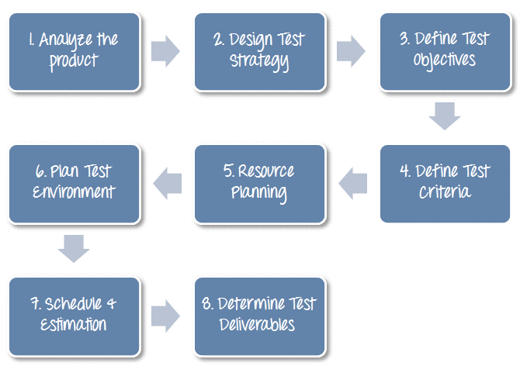
How to write a Test Plan

Slide 5
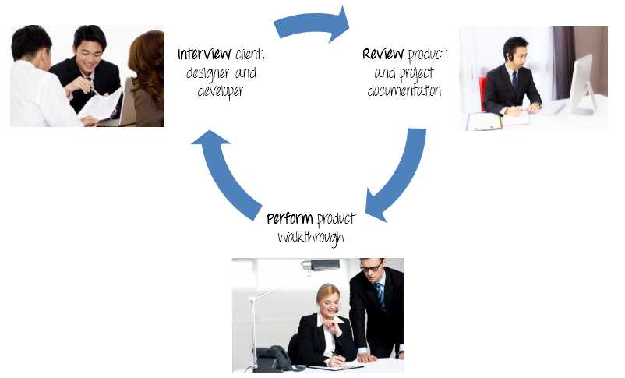
Step 1) Analyze the product
How can you test a product without any information about it? The answer is Impossible. You must learn a product thoroughly before testing it.
Example: The product under test is Guru99 banking website. You should research clients and the end users to know their needs and expectations from the application
Who will use the website?
What is it used for?
How will it work?
What are software/ hardware the product uses?
You can use the following approach to analyze the site
You should take a look around this website and also review product documentation. Review of product documentation helps you to understand all the features of the website as well as how to use it. If you are unclear on any items, you might interview customer, developer, designer to get more information.

Slide 6

Step 1) Analyze the product

Slide 7
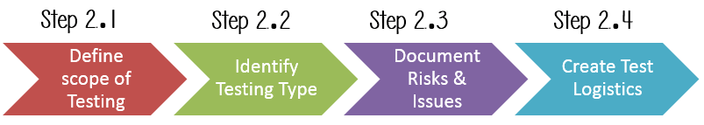
Step 2) Develop Test Strategy
Test Strategy is a critical step in making a Test Plan in Software Testing. A Test Strategy document, is a high-level document, which is usually developed by Test Manager. This document defines:
The project’s testing objectives and the means to achieve them
Determines testing effort and costs
Back to your project, you need to develop Test Strategy for testing that banking website. You should follow steps below

Slide 8
Step 2.1) Define Scope of Testing
Before the start of any test activity, scope of the testing should be known. You must think hard about it.
The components of the system to be tested (hardware, software, middleware, etc.) are defined as “in scope“
The components of the system that will not be tested also need to be clearly defined as being “out of scope.”
Defining the scope of your testing project is very important for all stakeholders. A precise scope helps
Give everyone a confidence & accurate information of the testing you are doing
All project members will have a clear understanding about what is tested and what is not
How do you determine scope your project?
To determine scope, you must –
Precise customer requirement
Project Budget
Product Specification
Skills & talent of your test team

Slide 9
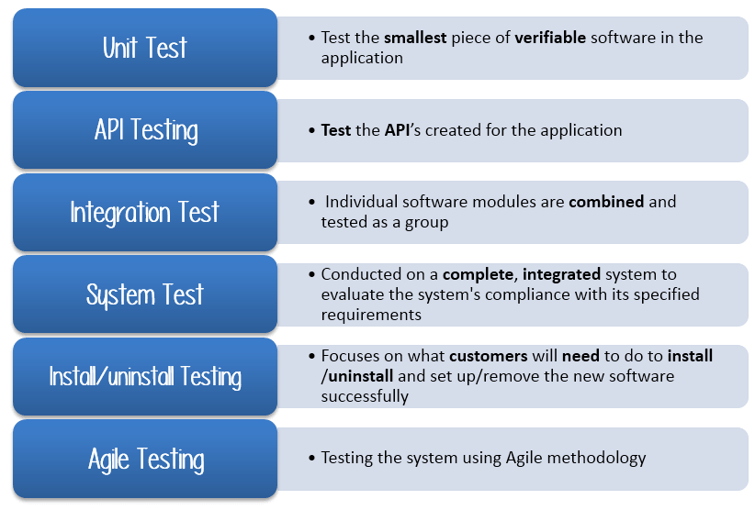
Step 2.2) Identify Testing Type
A Testing Type is a standard test procedure that gives an expected test outcome.
Each testing type is formulated to identify a specific type of product bugs. But all Testing Types are aimed at achieving one common goal “Early detection of all the defects before releasing the product to the customer”
There are tons of Testing Types for testing software product. Your team cannot have enough efforts to handle all kind of testing. As Test Manager, you must set priority of the Testing Types
Which Testing Types should be focused for web application testing?
Which Testing Types should be ignored for saving cost?
Commonly Used Test Types

Slide 10
Step 2.3) Document Risk & Issues
Risk is future’s uncertain event with a probability of occurrence and a potential for loss. When the risk actually happens, it becomes the ‘issue’.
Risk | Mitigation
Team member lack the required skills for website testing. | Plan training course to skill up your members
The project schedule is too tight; it’s hard to complete this project on time | Set Test Priority for each of the test activity.
Test Manager has poor management skill | Plan leadership training for manager
A lack of cooperation negatively affects your employees’ productivity | Encourage each team member in his task, and inspire them to greater efforts.
Wrong budget estimate and cost overruns | Establish the scope before beginning work, pay a lot of attention to project planning and constantly track and measure the progress
In the QA Test Plan, you will document those risks

Slide 11

Step 2.4) Create Test Logistics
In Test Logistics, the Test Manager should answer the following questions:
Who will test?
When will the test occur?
Who will test?
You may not know exact names of the tester who will test, but the type of tester can be defined. To select the right member for specified task, you must consider if his skill is qualified for the task or not, also estimate the project budget.
Selecting wrong member for the task may cause the project to fail or delay.
Person having the following skills is most ideal for performing software testing:
Ability to understand customers point of view
Strong desire for quality
Attention to detail
Good cooperation
In your project, the member who will take in charge for the test execution is the tester. Base on the project budget, you can choose in-source or outsource member as the tester.
When will the test occur?
Test activities must be matched with associated development activities. You will start to test when you have all required items

Slide 12
Step 3) Define Test Objective
Test Objective is the overall goal and achievement of the test execution. The objective of the testing is finding as many software defects as possible; ensure that the software under test is bug free before release.
To define the test objectives, you should do 2 following steps
1. List all the software features (functionality, performance, GUI…) which may need to test.
Define the target or the goal of the test based on above features
You can choose the ‘TOP-DOWN’ method to find the website’s features which may need to test. In this method, you break down the application under test to component and

Slide 13
Step 4) Define Test Criteria
Test Criteria is a standard or rule on which a test procedure or test judgment can be based. There’re 4 types of test criteria as following
Entry criteria:
A set of guidelines used to determine whether a system under test is ready to move or enter a particular phase of testing.
e.g :We can start System testing once the code has passed unit testing.
Exit criteria:
A set of guidelines used to determine whether a system under test is ready to exit a particular phase of testing. When exit criteria is met, either the system under test moves on to the next test phase or the test project is considered complete.
Suspension Criteria:
The testing process is suspended when no further testing is feasible. It can happen due to several reasons like the system under test repeatedly fails or crashes (due to defect).
Resumption Criteria:
When the defect is fixed and testing can be resumed , is known as resumption criteria.
These criteria’s are normally mentioned in the test plan which helps to save the project time and cost.

Slide 14
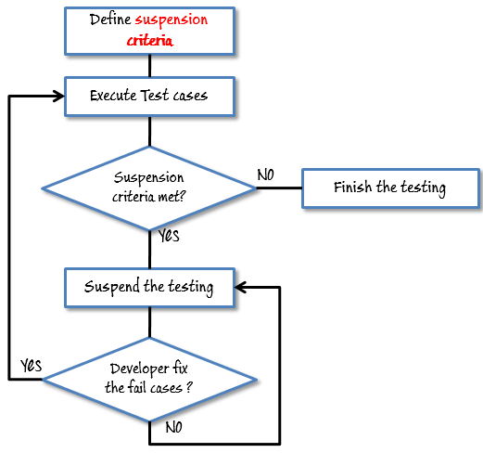
Suspension Criteria Example
Test Plan Example: If your team members report that there are 40% of test cases failed, you should suspend testing until the development team fixes all the failed cases.

Slide 15
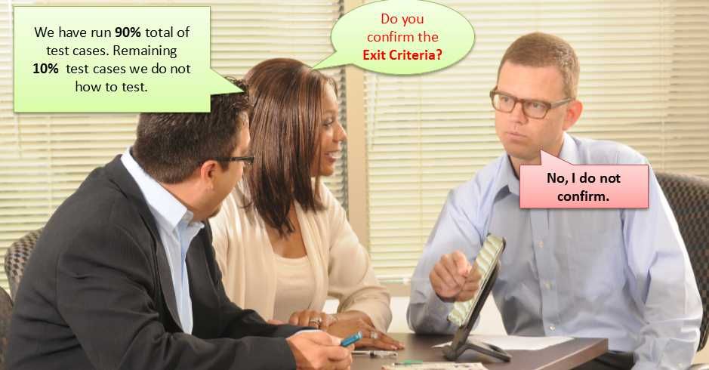
Exit criteria example
Example: 95% of all critical test cases must pass. Some methods of defining exit criteria are by specifying a targeted run rate and pass rate.
Run rate is ratio between number test cases executed/total test cases of test specification. For example, the test specification has total 120 TCs, but the tester only executed 100 TCs, So the run rate is 100/120 = 0.83 (83%)
Pass rate is ratio between numbers test cases passed / test cases executed. For example, in above 100 TCs executed, there’re 80 TCs that passed, so the pass rate is 80/100 = 0.8 (80%)
This data can be retrieved in Test Metric documents.
Run rate is mandatory to be 100% unless a clear reason is given.
Pass rate is dependent on project scope, but achieving high pass rate is a goal.
Test Plan Example:Your Team has already done the test executions. They report the test result to you, and they want you to confirm the Exit Criteria.
In above case, the Run rate is mandatory is 100%, but the test team only completed 90% of test cases. It means the Run rate is not satisfied, so do NOT confirm the Exit Criteria

Slide 16
Step 5) Resource Planning
Resource plan is a detailed summary of all types of resources required to complete project task. Resource could be human, equipment and materials needed to complete a project
The resource planning is important factor of the test planning because helps in determining the number of resources (employee, equipment…) to be used for the project. Therefore, the Test Manager can make the correct schedule & estimation for the project.

Slide 17
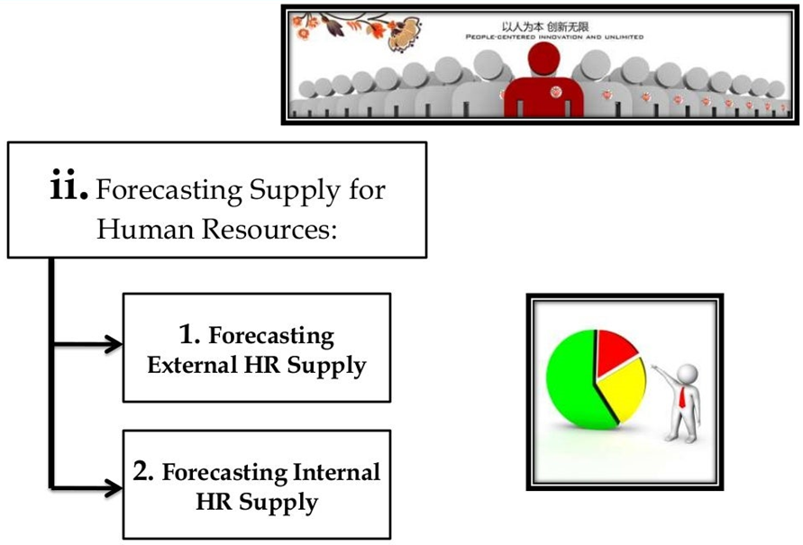
Human Resource EXAMPLE
The following table represents various members in your project team
No. | Member | Tasks
1. | Test Manager | Manage the whole project Define project directions Acquire appropriate resources
2. | Tester | Identifying and describing appropriate test techniques/tools/automation architecture Verify and assess the Test Approach Execute the tests, Log results, Report the defects. Tester could be in-sourced or out-sourced members, base on the project budget For the task which required low skill, I recommend you choose outsourced members to save project cost.
3. | Developer in Test | Implement the test cases, test program, test suite etc.
4. | Test Administrator | Builds up and ensures Test Environment and assets are managed and maintained Support Tester to use the test environment for test execution
5. | SQA members | Take in charge of quality assurance Check to confirm whether the testing process is meeting specified requirements

Slide 18
System Resource EXAMPLE
The following table represents various members in your project team
No. | Resources | Descriptions
1. | Server | Install the web application under test This includes a separate web server, database server, and application server if applicable
2. | Test tool | The testing tool is to automate the testing, simulate the user operation, generate the test results There are tons of test tools you can use for this project such as Selenium, QTP…etc.
3. | Network | You need a Network include LAN and Internet to simulate the real business and user environment
4. | Computer | The PC which users often use to connect the web server

Slide 19

Step 6) Plan Test Environment
A testing environment is a setup of software and hardware on which the testing team is going to execute test cases. The test environment consists of real business and user environment, as well as physical environments, such as server, front end running environment.
How to setup the Test Environment?
To finish this task, you need a strong cooperation between Test Team and Development Team
Developer can ask some questions to understand the web application under test clearly. Here’re some recommended questions. Of course, you can ask the other questions if you need.
What is the maximum user connection which this website can handle at the same time?
What are hardware/software requirements to install this website?
Does the user’s computer need any particular setting to browse the website?

Slide 20
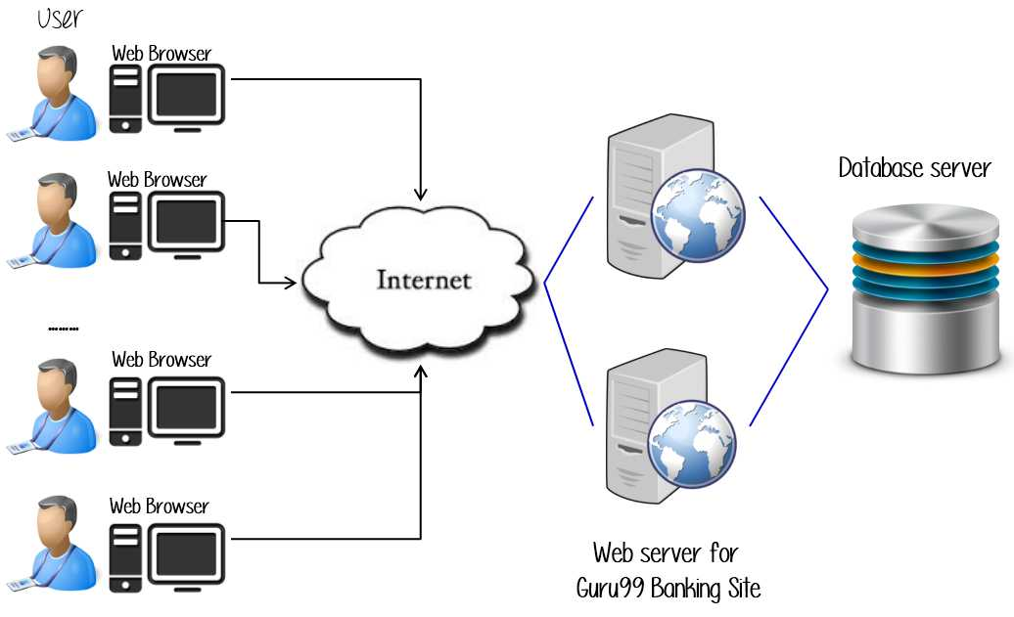
Example-- test environment of the banking website
http://demo.guru99.com/V4

Slide 21
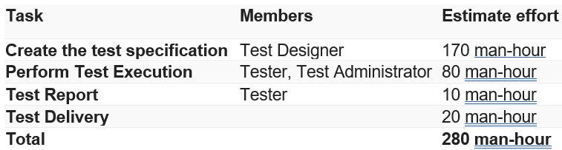
Step 7) Schedule & Estimation
In the Test Estimation phase, suppose you break out the whole project into small tasks and add the estimation for each task as below

Slide 22
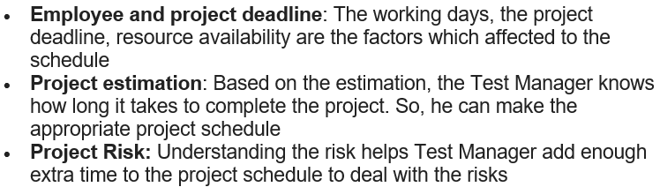
Schedule and estimations conti…
Then you create the schedule to complete these tasks.
Making schedule is a common term in project management. By creating a solid schedule in the Test Planning, the Test Manager can use it as tool for monitoring the project progress, control the cost overruns.
To create the project schedule, the Test Manager needs several types of input as below:

Slide 23
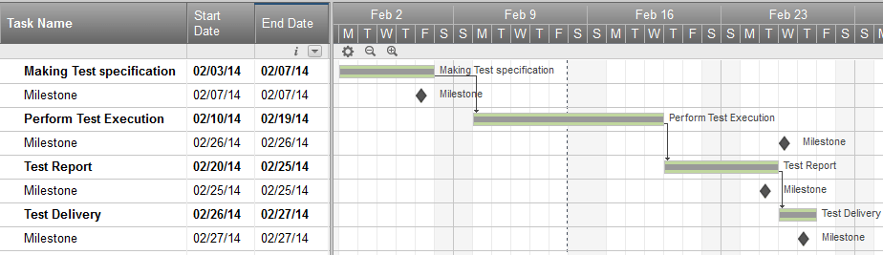
Schedule and estimations Example
Suppose the boss wants to complete the project abc in one month, you already estimated the effort for each tasks in Test Estimation. You can create the schedule as below

Slide 24

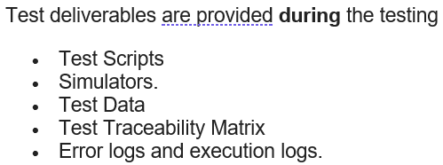
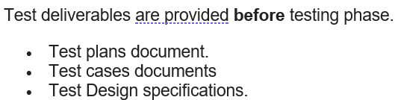
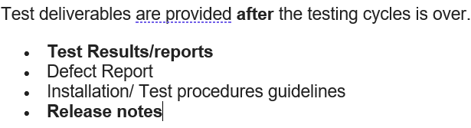
Step 8) Test Deliverables
Test Deliverables is a list of all the documents, tools and other components that has to be developed and maintained in support of the testing effort.
There are different test deliverables at every phase of the software development lifecycle.

Slide 25
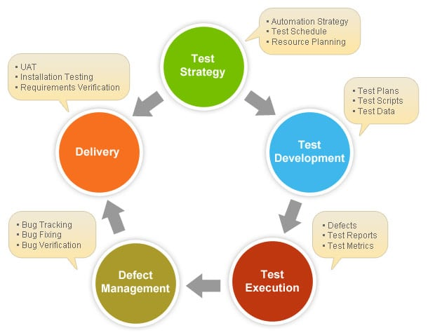
Test plan procedures

Slide 26
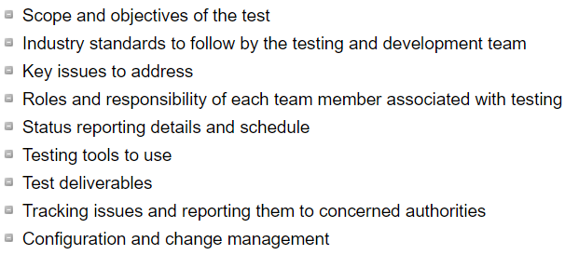
Critical components of a test strategy document

Slide 27
Test Strategy vs. Test Plan
If you are new to testing, it's not uncommon to confuse with test plan and test strategy. The test planning document comprises both strategies along with the project plan. In short, the strategy document is a sub-item of a test plan.
The test plan includes the project scope and tests focus. Generally, it contains the complete test coverage mentioning which features to test and which should be left untested. It also defines the estimation, resource management, and scheduling of the test.
Test strategy includes the test approach that needed to be followed to achieve the objectives of the test plan. It's up to the company standards whether they want to prepare a separate test targeted document or combine both the documents in one.
To summarize, a test plan is a vision, which test strategy defines the action required for achieving that vision.

Slide 28
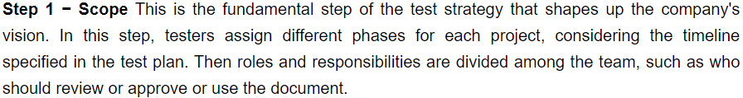
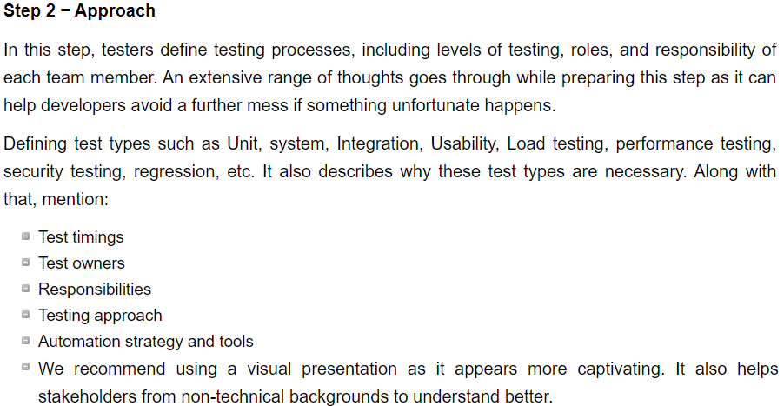
Preparing the best test strategy document

Slide 29
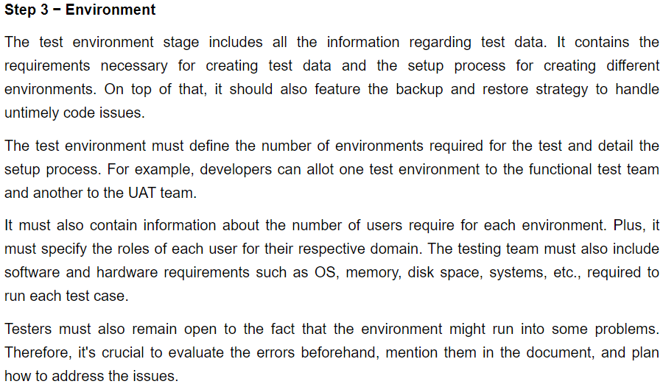
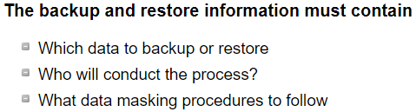
Preparing the best test strategy document

Slide 30
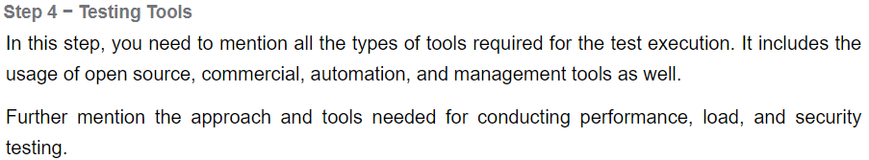
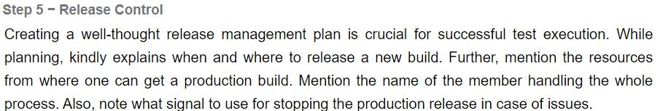
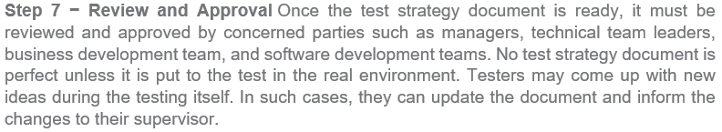
Preparing the best test strategy document

Slide 31
Testing documentation: frequent mistakes
Example #1
Your team has grown and it has become difficult to transfer information about processes. The number of issues has grown and all the development processes have slowed down. Despite the lack of project time, you will save a lot more time by introducing test documentation: newly joined QA engineers can read about your processes autonomously and come back to their description when necessary.

Slide 32
Testing documentation: frequent mistakes
Example #2
Imagine the following situation: the project had vague exit criteria. Each team member interpreted them their own way, which resulted in major bugs crashing into the release. As a result, the product release had to be postponed for a few weeks, because the team logged the wrong severity level.
This was only an example of how incomplete quality criteria can affect product development. If you have already encountered such an issue, it’s time to think about formalizing quality and acceptance criteria via the test plan section.
Good release criteria examples:
“All tickets in the release backlog are implemented, deployed, and tested in accordance with the acceptance criteria and ticket description.”
“Complete set of manual and automated tests passed after code freeze.”
“All E2E scenarios are completed.”
“All failed scripts have been analyzed with bug reports added to the bug tracker.”
“Compatibility tests passed in accordance with the first priority list of browsers and OS described in the test strategy.”
“No open bugs with Critical or Major priority.”

Slide 33
Testing documentation: frequent mistakes
Example #3
During testing, the team may encounter various problems that can affect timing or quality: dropped testing environments, a team member taking sick leave, unexpected code freeze, poor requirement details, changes in requirements when they are half-finished, and so on. The team should have an emergency plan to minimize the damage from the triggered risk and a plan of countermeasures to prevent such risks. This is why I think risk assessment is one of the most important sections of the test plan. It consists of a list of risks, their likelihood, impact on the testing process, priority, and a response plan.

Slide 34
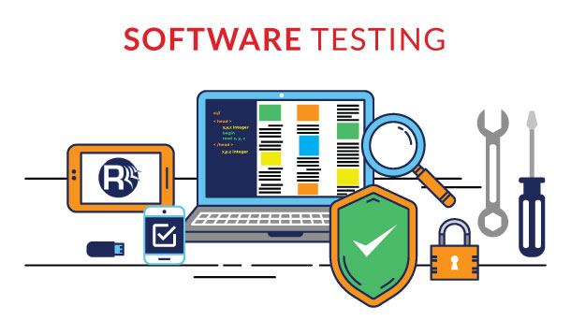
Any Questions

